Slide 1
Mindful Reflection
Meta-awareness as cortical novelty?
The Brain on the Mind & the Mind on the Brain
Henk Barendregt
&
the Mind Brain Mindfulness Research Team

Slide 2
Mindfulness
Mindfulness = to be aware
Attention → awareness

Slide 3
Mindfulness
Why mindfulness?
The moment of mindfulness itself is already valuable.
“Each moment of mindfulness is a moment of enlightenment.”
→ experiencing sensory input
→ experiencing a treat

Slide 4
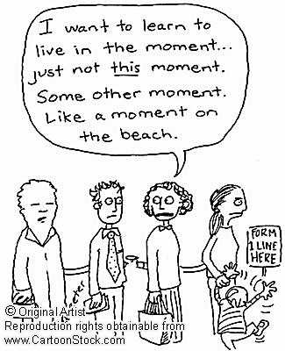
Mindfulness

Slide 5
Mindfulness
Freedom from suffering (not freedom from pain)
- seeing things as they are
- metacognition; disidentification
- thinking, feeling and attending are distinct phenomena

Slide 6
Mindfulness
Measuring mindfulness
Mesurement by self-report
Examples (from the Kentucky Inventory of Mindfulness Skills):
-I notice changes in my body, such as whether my breathing slows down or speeds up.
-I notice the smells and aromas of things.
-When I have a sensation in my body, it's difficult for me to describe it because I can't find the right words
-I drive on “automatic pilot” without paying attention to what I'm doing.
-When I'm doing chores, such as cleaning or laundry, I tend to daydream or think of other things.
-I pay attention to sounds, such as clocks ticking, birds chirping, or cars passing.

Slide 7
Mindfulness
Mindfulness and effects on well-being
MBCT in patients with recurring depressive episodes
50% less risk for another episode
MBSR reduces psychological distress symptoms in anxiety and pain patients
“Mindfulness may be important in disengaging individuals from automatic thoughts, habits and unhealthy behavior patterns and thus could play a key role in fostering informed and self-endorsed behavioral regulation, which has long been associated with well-being enhancement.” (KW Brown and RM Ryan 2003)
Acceptance by perceiving stimuly simply “as they are”.

Slide 8
Mindfulness
Mindlessness
automaticity saves time and frees the mind for more important tasks
problematic consequences:
-forgetfulness
-rigidity
-wrong view
the deployment of conscious attention can override unwanted responses

Slide 9
Mindfulness
Let's all be mindful from now on....

